Slide 1
Geolocation Overview
CS235AM
Android App Development
by Brian Bird
Spring 2016
Lane Community College

Slide 2
Course Schedule
Wk | Topic
1 | Intro + single-screen apps
2 | Multi-screen (multi-activity) apps
3 | Activity lifecycle and state
4 | List Views + Adapters
5 | Layouts + orientation
Wk | Topic
6 | Adapting to size and orientation: fragments
7 | Managing data: SQLite
8 | Consuming web services
9 | Geolocation
10 | Publishing to the Google Play Store

Slide 3
This Week’s Assignments
Due Tuesday
Reading quiz 9, geolocation
Due Saturday
Lab 8, tide app with web service, final version
Lab 9 beta, tide app with geolocation

Slide 4
Next Week’s Assignments
Due next Tuesday
Reading quiz 10, Google Play Store
Due next Saturday
Lab 9 final version, tide app with geolocation
Term project beta

Slide 5

Google io 2016

Slide 6
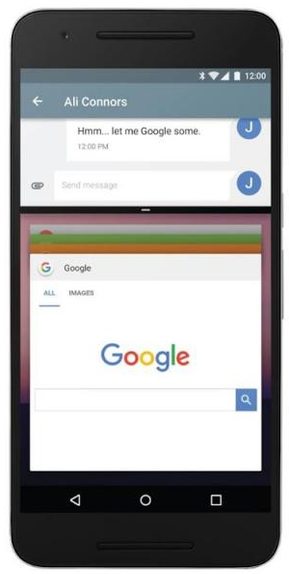
Google I/O Announcement: Android N
Multi-window (two apps on screen!)
OS updates in the background
Vulcan 3D: high performance rendering
Daydream: Successor to Cardboard VR, new headsets coming
Faster, more efficient Java JIT compiler
Coming later this summer

Slide 7
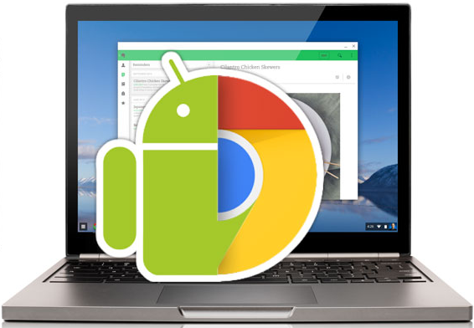
Google I/O Announcement: Android Apps on Chrome
Google Play Store on Chrome
Available Imminently

Slide 8
More Google I/O Announcements
Allo: new chat app (competes with FB messenger)
Assistant: with better AI than Google Now
Duo: Video calling (like FaceTime)
Android Wear 2.0: No phone tether needed
Instant Apps: Load just a piece of an app on your device, loads like a web page
Firebase 2.0: Free service for developers, providing app usage analytics, cloud APIs, app testing, and more

Slide 9
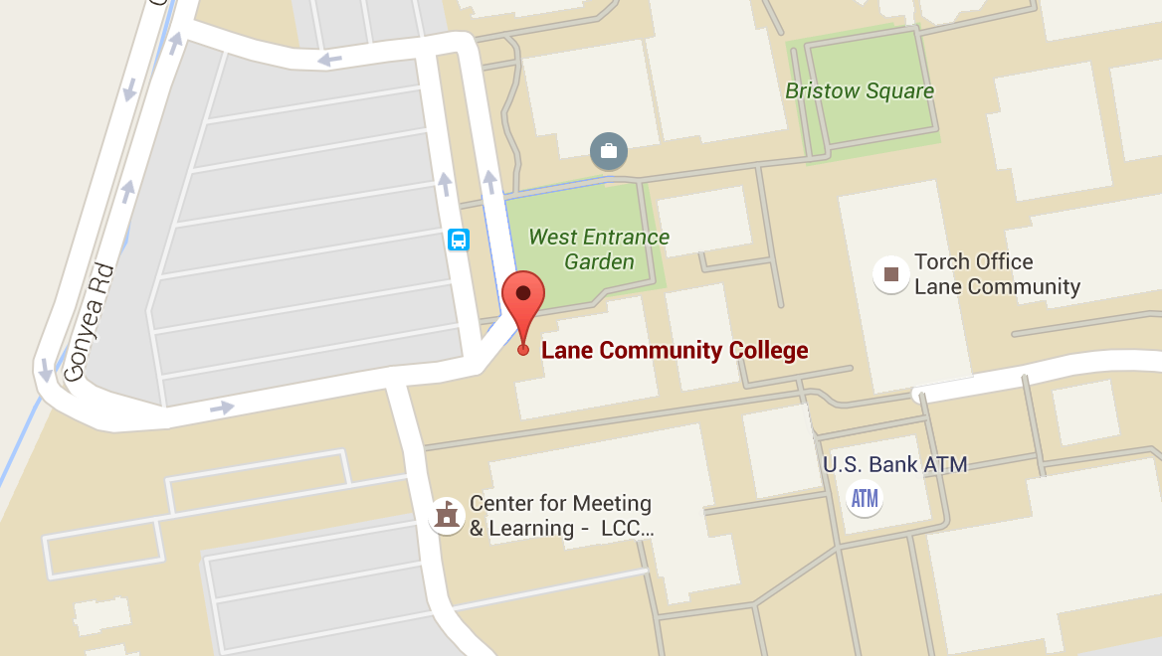
Geolocation
Notes:
Tutorial: https://developer.android.com/training/location/index.html

Slide 10
Geolocation APIs
Information provided:
Latitude and longitude
Altitude
Speed
Heading

Slide 11
Location Data Sources
Source | Accuracy | Battery Drain
GPS | High | Highest
Cellular Towers | Medium | Lower
Wi-Fi | Variable: medium to low | Lower
Notes:
https://developer.android.com/guide/topics/location/strategies.html

Slide 12
Choice of APIs
Android Location Services API
Lets you choose between: GPS, Cellular, Wi-Fi
No longer recommended by Google
Fused Location Provider
Dynamically chooses the best location provider
Preferred by Google, requires Google Play Services
Xamarin Geolocator Plugin
Cross-platform: Android, iOS, Windows
Notes:
Xamarin tutorial on the first two APIs listed above: https://developer.xamarin.com/guides/android/platform_features/maps_and_location/location/

Slide 13
Fused Location Provider
Location sources are selected based on priorities:
Balanced power/accuracy
~100 m accuracy
medium power draw
High accuracy
~5 meter accuracy
highest power draw
Low power
~10km accuracy
minimum power draw
No power
uses location data requested by other apps

Slide 14
Fused Location Provider
Gets the best available provider
Provides last known location (usually current)
Provides continuous location updates
Location client
Connects to Google Play Services
Developer needs to implement interfaces for callbacks
Notes:
https://developer.android.com/training/location/retrieve-current.html

Slide 15
Related APIs
Geocoder
Get address from latitude and longitude
Get latitude and longitude from address
Geofencing
Monitor distance from a point of interest
Get notifications when entering or leaving area of interest

